Slide 1
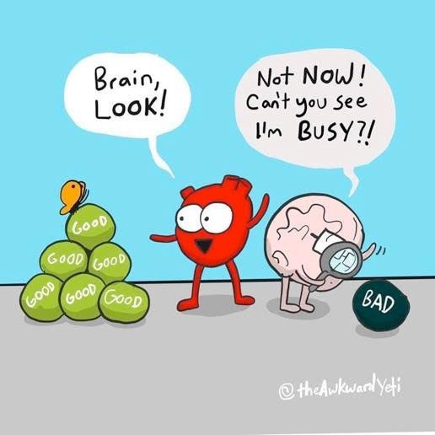

Slide 2
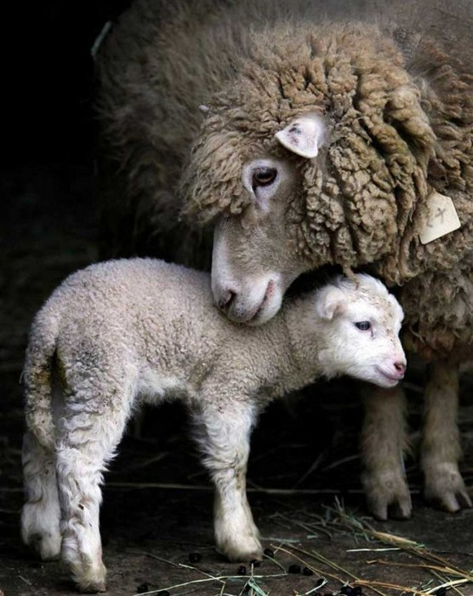
Stress Response | Stress Response turned inwards | Self-Compassion
Fight | Self-criticism | Yin Compassion
Flight | Isolation | Common Humanity
Freeze | Rumination | Mindfulness
Fawn | People pleasing | Yang Compassion
Notes:
10:47-10:50
Not our fault, but our responsibility

Slide 3
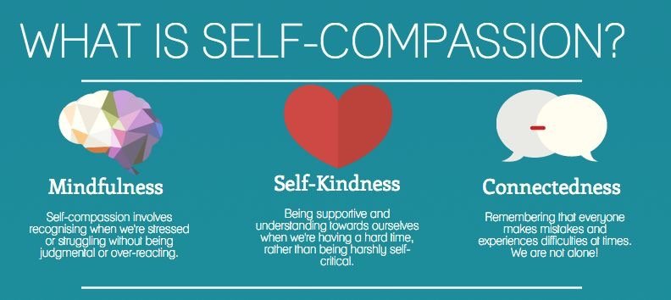
Kristin Neff 2003
Notes:
10:17-10:20
Noticing when you are suffering.
Wishing to alleviate suffering.
Showing kindness to self, to alleviate suffering.
Suffering is inevitable in human existence.
In Mindful Self Compassion we use a mindful state of mind to turn towards suffering with kindness, instead of resisting and causing more suffering.
Three components (Kristin Neff)
10:25

Slide 4
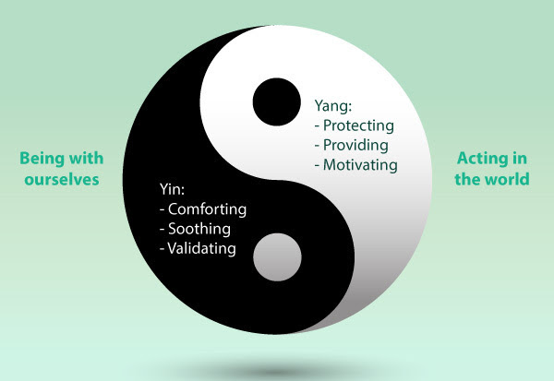
Notes:
12:00-12:05

Slide 5
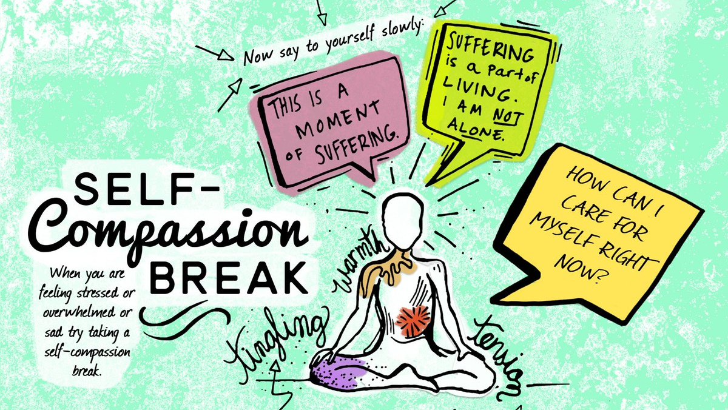
Notes:
12:10-12:20

